Slide 1
TypeScript Essentials
Getting started with TypeScript
Functions
Classes
Inheritance and interfaces

Slide 2
1. Getting Started with TypeScript
Overview
Using the TypeScript Playground
Defining types in declarations
TypeScript basic types
Arrays
Tuples
Enums

Slide 3
Overview
You can use TypeScript to enhance the type-safety of your React applications
TypeScript supports ES6++ features, plus…
Data typing ☺
Interfaces
Decorators (similar to annotations in Java)
Class member variables (i.e. fields)
Generics
Keywords public, private, protected
3

Slide 4
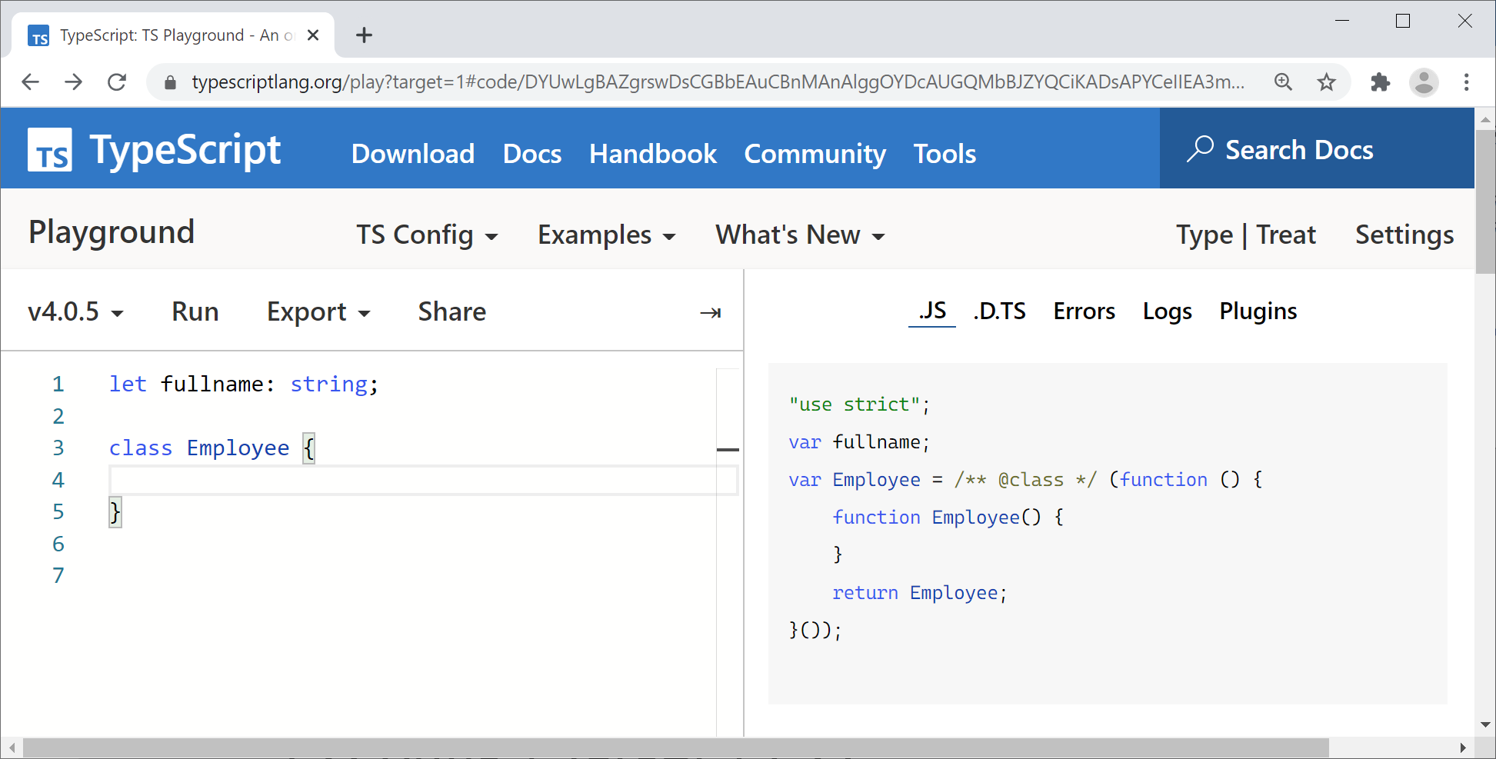
Using the TypeScript Playground
There's a handy TypeScript transpiler available online, where you can practice your TypeScript skills
http://www.typescriptlang.org/play/
Choose ES5 as the target language, via the menu TS Config | Target | ES5
Then try out some TS!
4

Slide 5
Defining Types in Declarations
TS allows you to define types in declarations
Variables, parameters, and function return types
Use the syntax variableName:type
Transpiles to
let name1 = 'Fred';
let name2: string = 'Wilma';
var name1 = 'Fred';
var name2 = 'Wilma';
TS code
ES5 code
5

Slide 6
TypeScript Basic Types (1 of 2)
number - floating point or integral number
boolean - true or false
string - literal text or template string `${x}`
function - a function
object - non-primitive type (e.g. object, array)
6

Slide 7
TypeScript Basic Types (2 of 2)
void - no type (e.g. function with no return)
never - function that never returns normally
any - disables type-checks, e.g. legacy code
null - data type of null value
undefined - data type of undefined value
7

Slide 8
Arrays
TS supports arrays
Use the type of the elements followed by []
Or use the generic array type Array<elemType>
Transpiles to
let a: number[] = [1,2];
let b: Array<number> = [3,4];
var a1 = [1,2];
var a2 = [3,4];
TS code
ES5 code
8

Slide 9
Tuples
TS supports tuples
Effectively an array of mixed types
let bd: [number, string];
bd = [3, 'December'];
let day: number = bd[0];
let month: string = bd[1];
var bd;
bd = [3, 'December'];
var day = bd[0];
var month = bd[1];
Transpiles to
ES5 code
TS code
9

Slide 10
Enums
TS supports enums, to represent a fixed set of states
Enum mnemonics can be strings
Transpiles to
enum Color {R=1, G, B};
let c: Color = Color.R;
var Color;
(function (Color) {
Color[Color["R"] = 1] = "R";
Color[Color["G"] = 2] = "G";
Color[Color["B"] = 3] = "B";
})(Color || (Color = {}));
var c = Color.R;
TS code
ES5 code
ES5 code
enum Color {R="rouge", G="vert", B="bleu"};
10

Slide 11
2. Functions
Typed parameters and returns
Default parameters
Optional parameters
Rest parameters
Lambda expressions

Slide 12
Typed Parameters and Returns
Functions in TS are similar to JS, but…
TS allows you to declare parameter and return types
TS performs type-checking
function calcTotalSalary(basic: number,
bonus: number,
director: boolean) : number {
var earnings: number = basic + bonus;
if (director) {
earnings *= 2;
}
return earnings;
}
12

Slide 13
Default Parameters
You can specify default values for parameters
Note:
Default params don't have to appear after required params - you can pass undefined to use a default
function calcTotalSalary(basic: number,
bonus: number = 0.0,
director: boolean = false) : number {
var earnings: number = basic + bonus;
if (director) {
earnings *= 2;
}
return earnings;
}
13

Slide 14
Optional Parameters
You can indicate parameter(s) are optional
Append question mark ? after the parameter name
Optional parameters must follow required parameters
In the function, check if the client passed in a value
function calcTotalSalary(basic: number,
bonus: number = 0.0,
director: boolean = false,
offshoreSlushFund?: number) : number {
var earnings: number = basic + bonus;
if (offshoreSlushFund) {
earnings += offshoreSlushFund;
}
if (director) {
earnings *= 2;
}
return earnings;
}
14

Slide 15
Rest Parameters
You can define variadic functions via "rest" parameters
Define an array parameter, precede param name with …
Must be at the end of the parameter list
function getFullName(fname: string, ...othernames: string[]) {
return fname + " " + othernames.join(" ");
}
15

Slide 16
Lambda Expressions
TS supports lambda expressions
() contain the params (you can omit () if only 1 param)
=> separates params from the lambda body
The lambda body is implicitly the return expression
You invoke a lambda expression like a regular function
var getFullName = (fn: string, ln: string): string => fn + ' ' + ln;
console.log(getFullName('Peter', 'John'));
16

Slide 17
3. Classes
Defining a simple class
Constructors
Read-only properties
Encapsulation
Constructor parameter properties
Defining additional methods
Defining static members

Slide 18
Defining a Simple Class
TS makes it much easier to define classes
Use the class keyword
Define members using familiar OO syntax
You can create objects using familiar JS syntax
class Employee {
name: string = '';
salary: number = -1;
}
let emp1 = new Employee();
emp1.name = "Paul";
emp1.salary = 42000;
18

Slide 19
Constructors
You can define a constructor in a class
Define a method named constructor
class Employee {
name: string;
salary: number;
constructor(name: string, salary: number) {
this.name = name;
this.salary = salary;
}
}
let emp1 = new Employee("Lydia", 43000);
19

Slide 20
Read-Only Properties
TypeScript has the concept of read-only fields
Declare a field with the readonly modifier
Must be initialized in constructor, can't be modified after
class Circle {
readonly radius: number;
constructor(radius: number) {
this.radius = radius;
}
}
let myCircle = new Circle(10);
console.log(myCircle.radius); // OK
myCircle.radius = 42; // Error
20

Slide 21
Encapsulation (1 of 2)
You can qualify members with access modifiers
public - accessible to anyone (this is the default)
protected - accessible to this class plus subclasses
private - accessible to this class only
You can also define getters and setters to encapsulate access to member variables
get xxx()
set xxx()
21

Slide 22
Encapsulation (2 of 2)
class Employee {
private _name: string;
private _salary: number;
constructor(_name: string, _salary: number) {
this._name = _name;
this._salary = _salary;
}
get name(): string {
return this._name;
}
set name(newName: string) {
this._name = newName;
}
get salary(): number {
return this._salary
}
}
let emp = new Employee("Thomas", 10000);
emp.name = "Tom";
console.log(`${emp.name} earns ${emp.salary}`);
22

Slide 23
Constructor Parameter Properties
The examples on the previous slides declared instance variables and initialized them in the constructor
This is such a common practice that TS provides a shortcut, "constructor parameter properties"
Define params as public/protected/private
TS automatically declares/initializes instance variables
class Employee {
constructor(private _name: string, private _salary: number) {}
…
}
23

Slide 24
Defining Additional Methods
You can define additional methods as necessary
Encapsulate logic and business rules for your class
class Employee {
constructor(private _name: string, private _salary: number) {}
payRise(amount: number): void {
this._salary += amount;
}
isHigherTax (): boolean {
return this._salary > 42000;
}
…
}
let emp = new Employee("Tom", 10000);
emp.payRise(100000);
console.log("Higher tax? " + emp.isHigherTax());
24

Slide 25
Defining Static Members (1 of 2)
You can define class-wide members
Belong to the whole class, not to a particular instance
To define a class wide member:
Prefix definition with static
Can also define as public/protected/private
Works for member variables and methods
To access a static member, prefix with class name
25

Slide 26
Defining Static Members (2 of 2)
Example
class Employee {
private static _taxThreshold: number = 42000;
constructor(private _name: string, private _salary: number) {}
isHigherTaxPayer(): boolean {
return this._salary > Employee._taxThreshold;
}
static get taxThreshold(): number {
return Employee._taxThreshold;
}
…
}
console.log("Tax threshold is " + Employee.taxThreshold);
26

Slide 27
4. Inheritance and Interfaces
Inheritance in TypeScript
Additional inheritance techniques
Using an interface to specify methods
Using an interface as a property bag
Using an interface as a func signature
Using an interface as an array type

Slide 28
Inheritance in TypeScript
A class can extend another class
The subclass uses the extends keyword
The subclass can override superclass methods
The subclass can invoke superclass methods and constructors, via the super keyword
Under the covers, TS inheritance is transpiled to prototypical inheritance in JavaScript
28

Slide 29
Additional Inheritance Techniques
Additional techniques in the superclass:
Can be abstract (cannot instantiate)
Can have abstract methods (must override(
Can have protected items (accessible to subclasses)
Additional techniques in client code
Downcast via instanceof and <type> typecasts
29

Slide 30
Using an Interface to Specify Methods
TS allows you to define interfaces, to specify methods that must be defined in implementation classes
A class can implement any number of interfaces
Via the implements keyword
interface ILoggable {
log(msg: string) : void;
}
interface ISerializable {
serialize() : void;
}
class MyClass implements ILoggable, ISerializable {
log(msg: string) : void {…}
serialize() : void {…}
}
30

Slide 31
Using an Interface as a Property Bag
An interface can specify a property bag
You can use the interface type in function parameters
Compiler ensures you pass in a compatible object
interface IShape {
cx: number; // Required.
cy: number; // Required
w: number; // Required.
h?: number; // Optional.
}
function useShape(shape: IShape) : void {
…
}
31

Slide 32
Using an Interface as a Func Signature
An interface can specify a function signature
Define an anonymous function inside the interface
You can use the interface when you declare a variable
Variable will point to a function of that signature
interface ISearchFunc {
(src: string, subStr: string): boolean;
}
let mySearchFunc: ISearchFunc;
mySearchFunc = function(sourceString: string, subString: string) {
return sourceString.search(subString) != -1;
}
32

Slide 33
Using an Interface as an Array Type (1)
An interface can specify an array type
Define an anonymous array inside the interface
Specify data type, and index type (number/string)
You can use the interface when you declare a variable
Indicates the variable is an array of the specified type
interface IStringArray {
[index: number]: string;
}
let cities: IStringArray;
cities = ["London", "Paris", "NY"];
console.log(cities[0]);
33

Slide 34
Using an Interface as an Array Type (2)
This example shows how to use a string index type
Effectively, it's a key-value dictionary
Usage:
interface IStringDictionary {
[index: string]: string;
}
let capitalCities: IStringDictionary = {};
capitalCities["Norway"] = "Oslo";
capitalCities["UK"] = "London";
capitalCities["Romania"] = "Bucharest";
console.log(capitalCities["Norway"]);
34

Slide 35
Summary
Getting started with TypeScript
Functions
Classes
Inheritance and interfaces

